Slide 1
2024-2025 Budget Workshop #1
January 8,2024
Board of Education Meeting

Slide 2
2024-25 Budget Workshop #1
GOAL
PROVIDE BUSINESS
DIRECTION THROUGH
TRANSPARENCY AND DETAIL.

Slide 3
2024-25 Budget Workshop #1
Staffing
Estimated Salaries
Benefits
Special Education
BOCES
Debt Service
Interfund Transfers

Slide 4
2024-25 Budget Workshop #1
STAFFING
3 ADMINISTRATORS
43 SUPPORT STAFF
53 TEACHERS

Slide 5
2024-25 Budget Workshop #1
NUMBER PROJECTIONS
BASED ON HISTORICAL BASELINES, CONSULTATION WITH TEAM AND BUSINESS COSTS

Slide 6
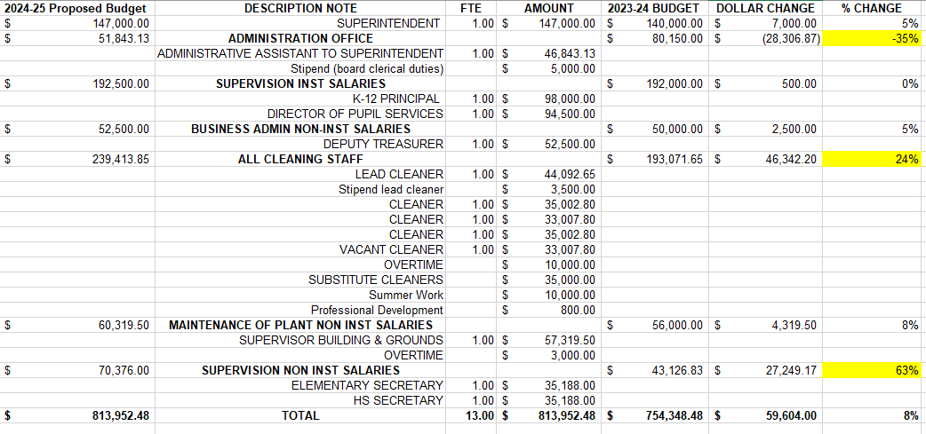
2024-25 Budget Workshop #1 ESTIMATED SALARIES

Slide 7
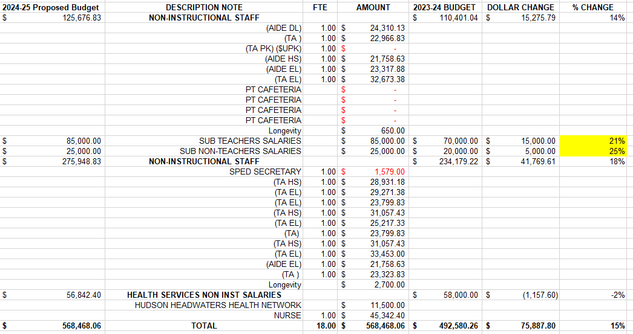
2024-25 Budget Workshop #1 ESTIMATED SALARIES

Slide 8
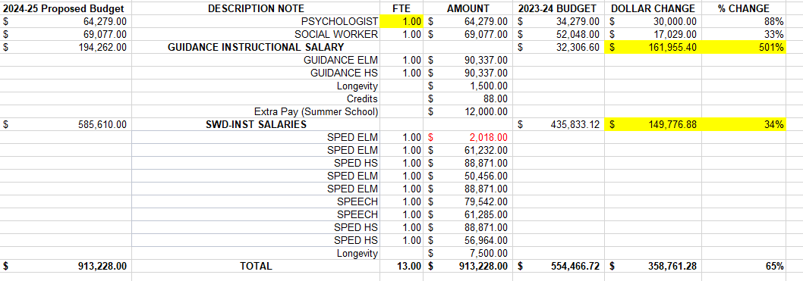
2024-25 Budget Workshop #1 ESTIMATED SALARIES

Slide 9
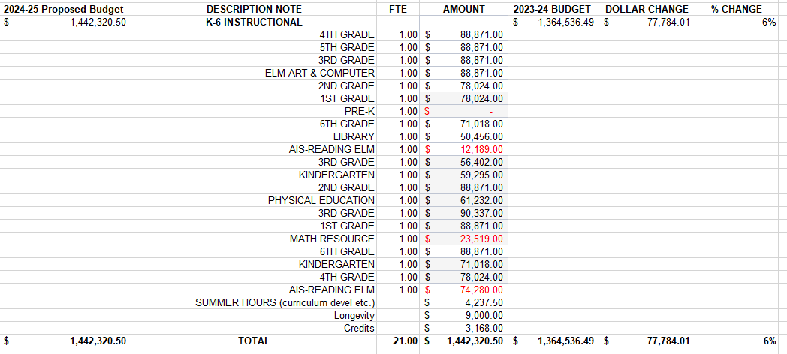
2024-25 Budget Workshop #1 ESTIMATED SALARIES K-6 INSTRUCTIONAL

Slide 10
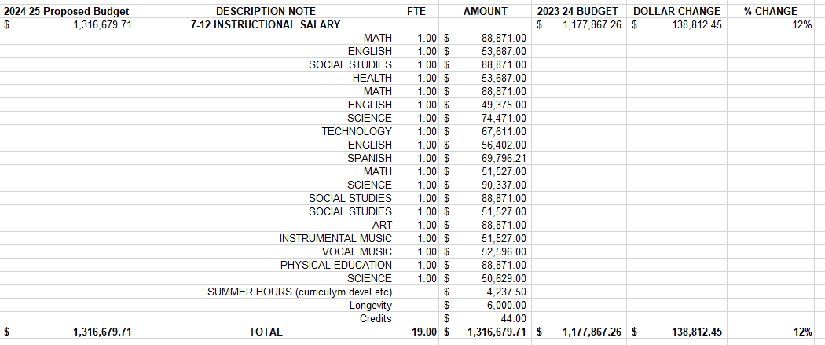
2024-25 Budget Workshop #1 ESTIMATED SALARIES 7-12 INSTRUCTIONAL

Slide 11
2024-25 Budget Workshop #1 ESTIMATED SALARIES

Slide 12
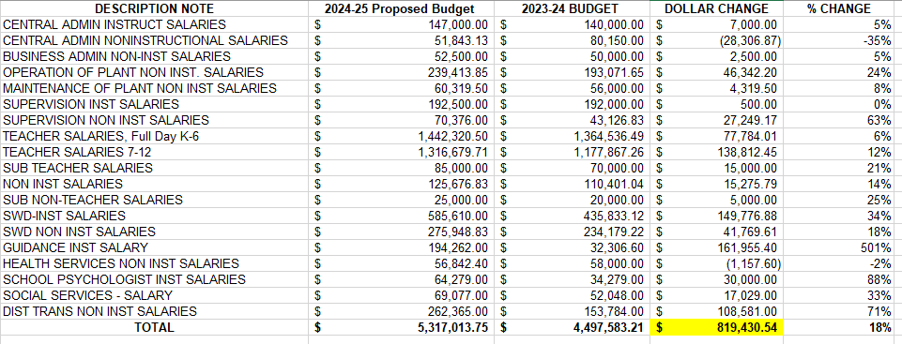
2024-25 Budget Workshop #1 ESTIMATED SALARIES SUMMARY

Slide 13
2024-25 Budget Workshop #1
BENEFITS
MEDICAL
DENTAL
RETIREMENT (TRS & ERS)
SOCIAL SECURITY
WORKERS’ COMPENSATION
UNEMPLOYMENT

Slide 14
2024-25 Budget Workshop #1
BENEFITS
MEDICAL & DENTAL

Slide 15
2024-25 Budget Workshop #1
BENEFITS
RETIREMENT (TRS & ERS)

Slide 16
2024-25 Budget Workshop #1
BENEFITS
SOCIAL SECURITY
WORKERS’ COMPENSATION
UNEMPLOYMENT

Slide 17
2024-25 Budget Workshop #1
BENEFITS SUMMARY

Slide 18
2024-25 Budget Workshop #1
SPECIAL EDUCATION

Slide 19
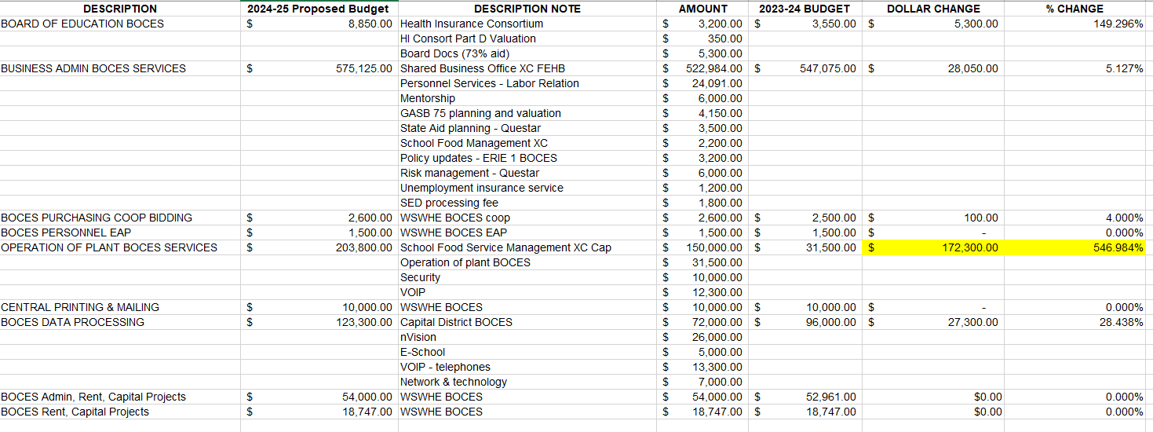
2024-25 Budget Workshop #1
BOCES

Slide 20
2024-25 Budget Workshop #1
BOCES

Slide 21
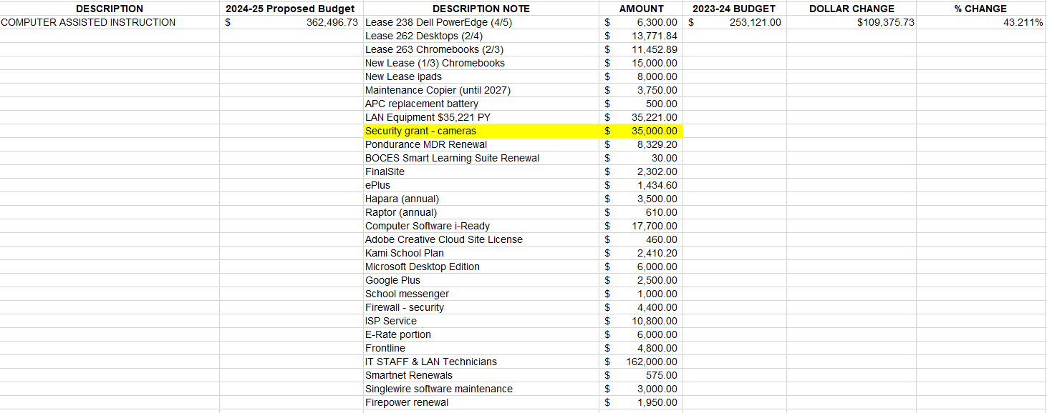
2024-25 Budget Workshop #1
BOCES

Slide 22
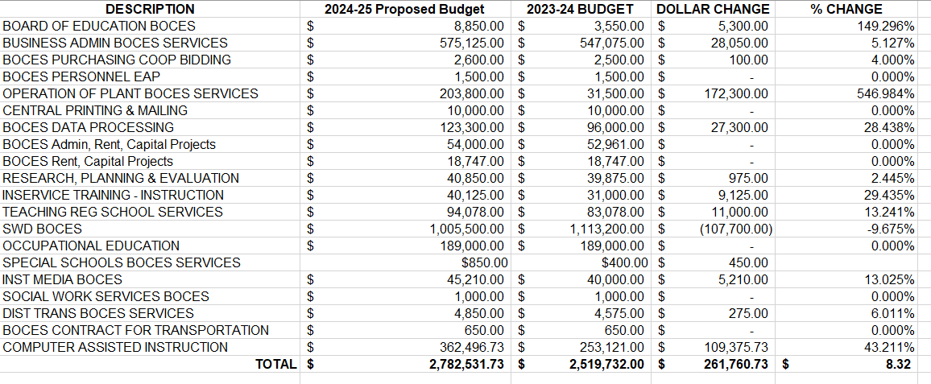
2024-25 Budget Workshop #1
BOCES SUMMARY

Slide 23
2024-25 Budget Workshop #1
DEBT SERVICE

Slide 24
2024-25 Budget Workshop #1
INTERFUND TRANSFERS

Slide 25
2024-25 Budget Workshop #1
QUESTIONS
???

